Slide 1

https://www.youtube.com/watch?v=RT5jRdhvu4k

Slide 2
Units of Energy – Joules, KiloJoules, and Calories
Miss Lum
Year 11 Essentials

Slide 3

Learning Outcomes
Dot Points
1.3.16 Use units of energy for foods, including kilojoules and calories
Contexts
Compare the nutritional energy between different types and amounts of foods and drinks

Slide 4
24
7
30
Units of Energy
Date: 01/04/2018
EQ – What are the Units of Energy?
What is energy?
Energy is needed to maintain our bodies and allow us to perform physical activity. The food and drink we consume provides us with this energy.
The energy provided by food is measured in joules, or kilojoules, (metric units) or in calories.
1 calorie ≈ 4.184 kilojoules, (kJ)
1 kilojoule = 1kJ = 1000 joules ≈ 0.239 calories
How is energy from food measured?

Slide 5
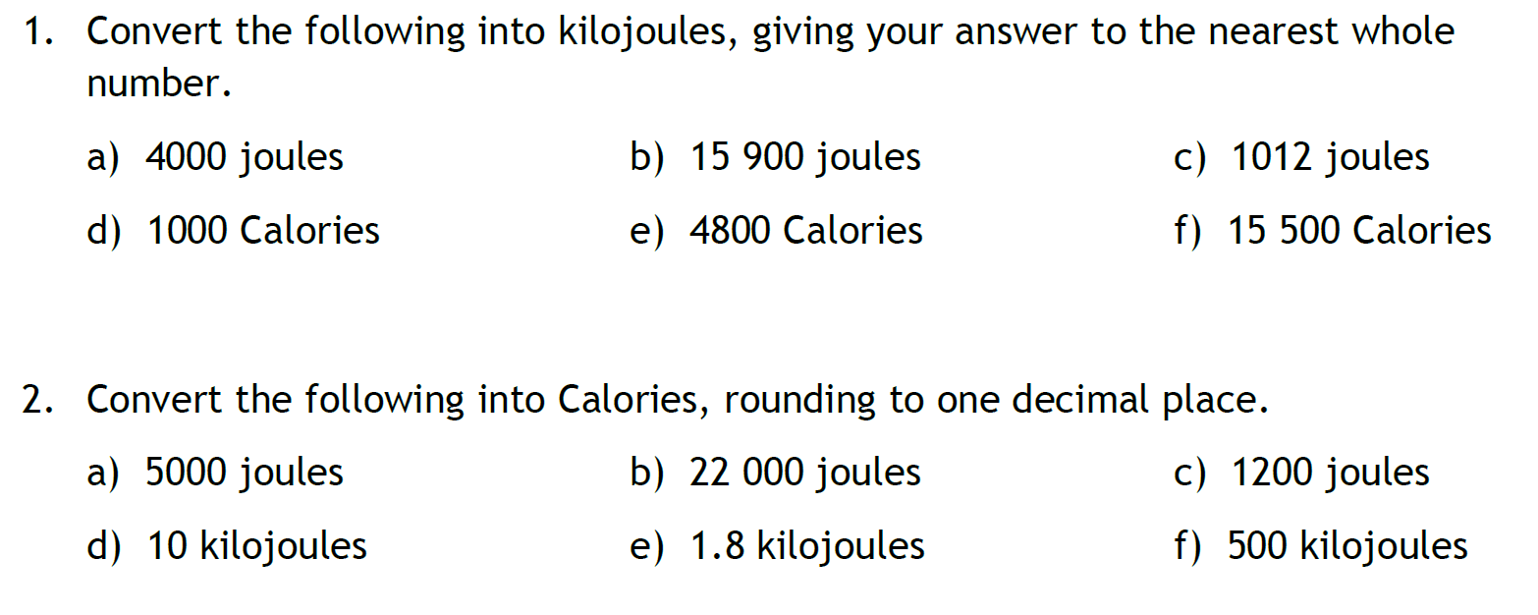
Guided Practice
4 kJ
16 kJ
1 kJ
4184 kJ
20 083 kJ
64 582 kJ
1.2 cal
5.3 cal
0.3 cal
2.4 cal
0.4 cal
119.5 cal

Slide 6
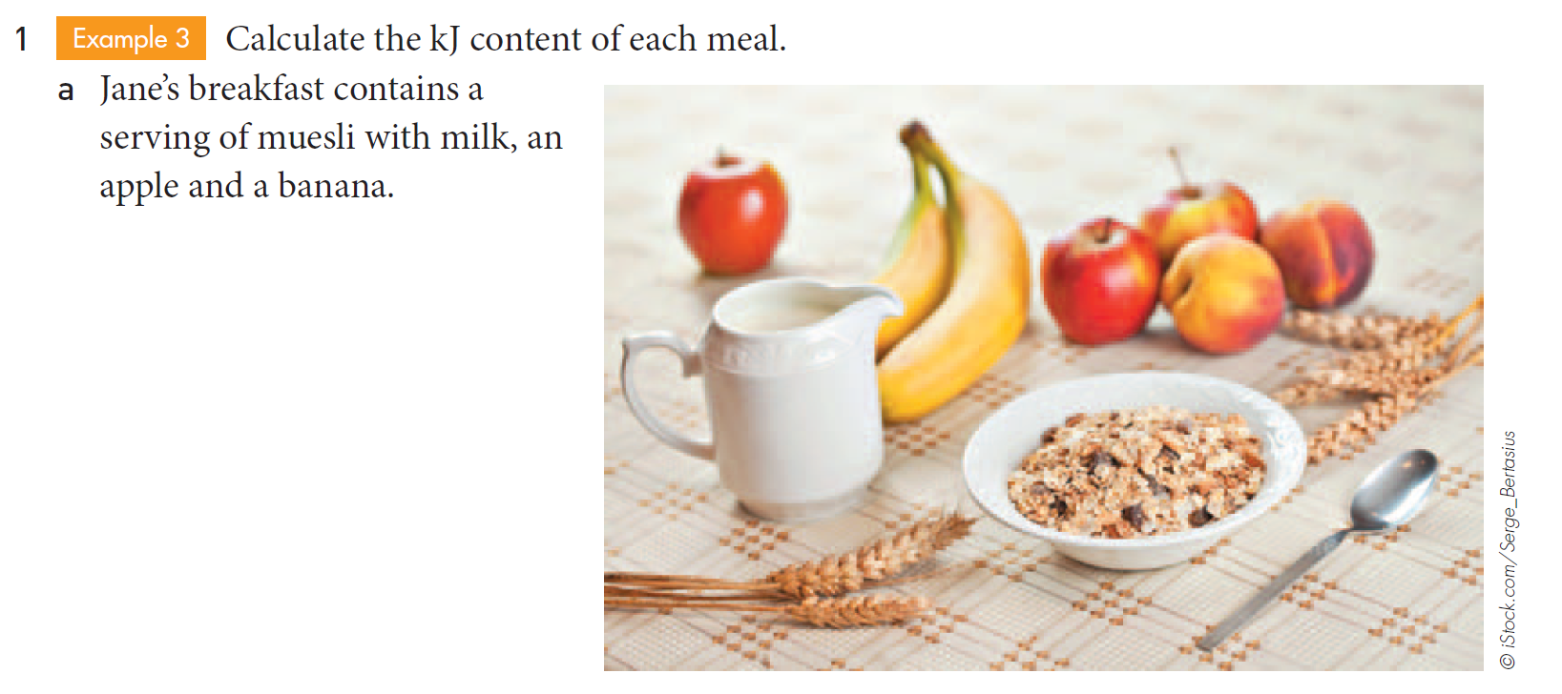
Task

Slide 7
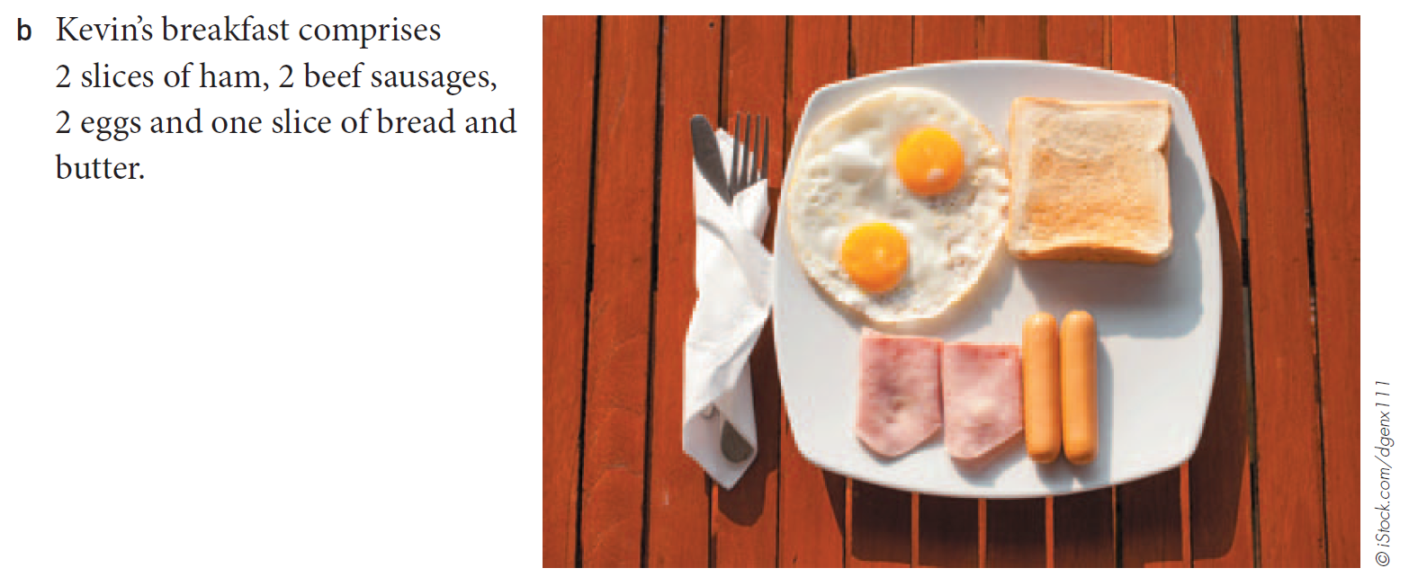
Task

Slide 8
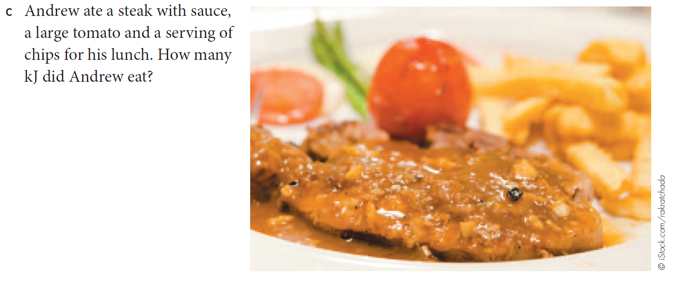
Task

Slide 9
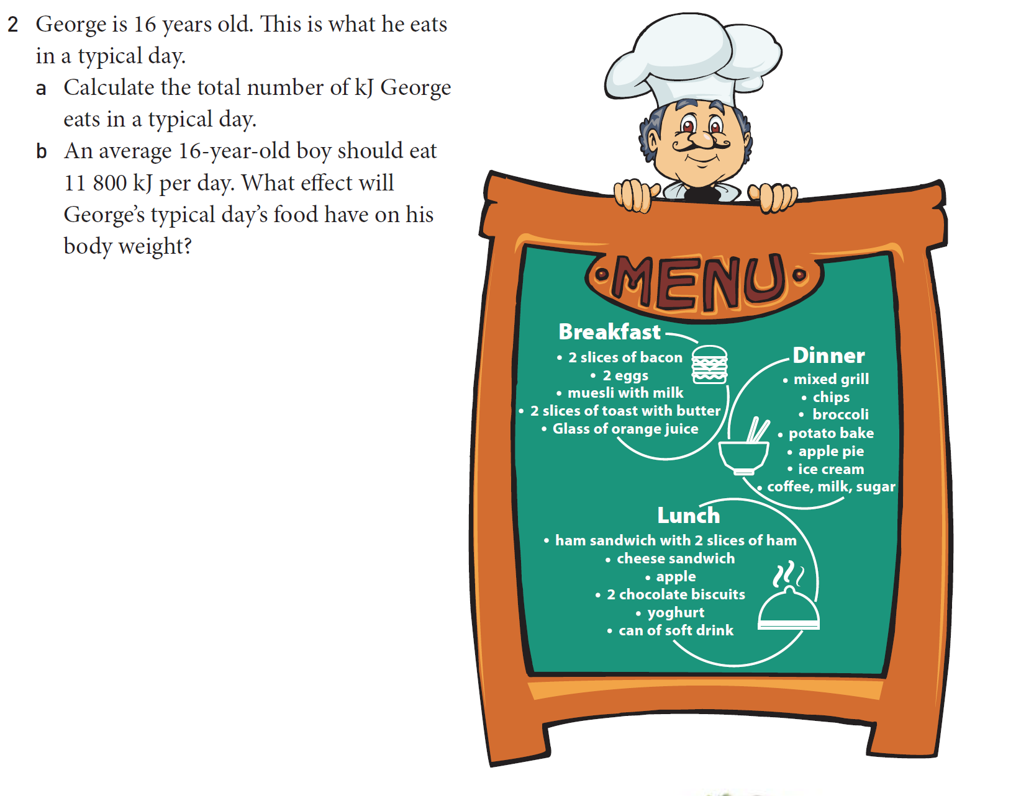
Task

Slide 10
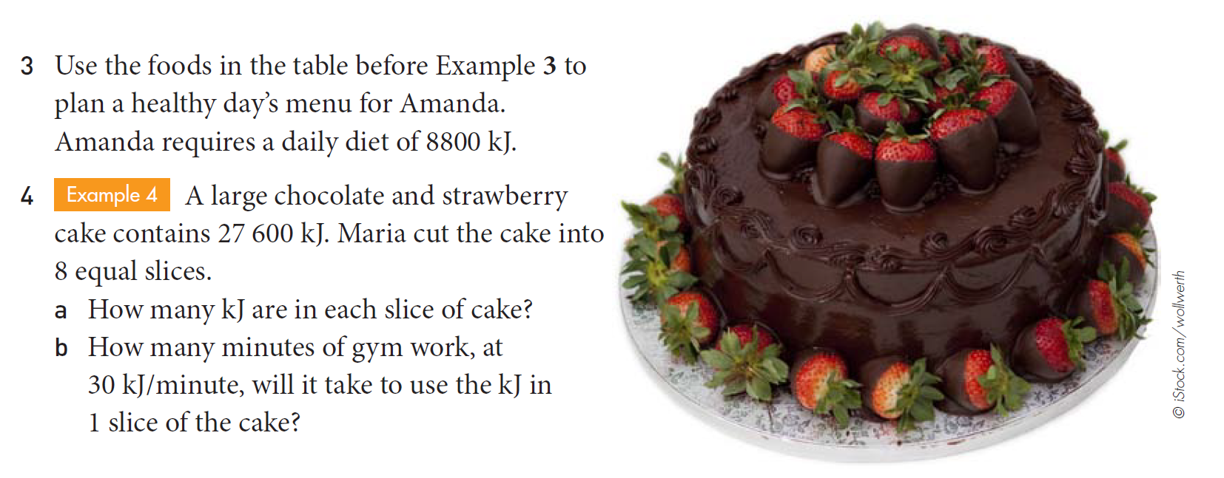
Task

Slide 11
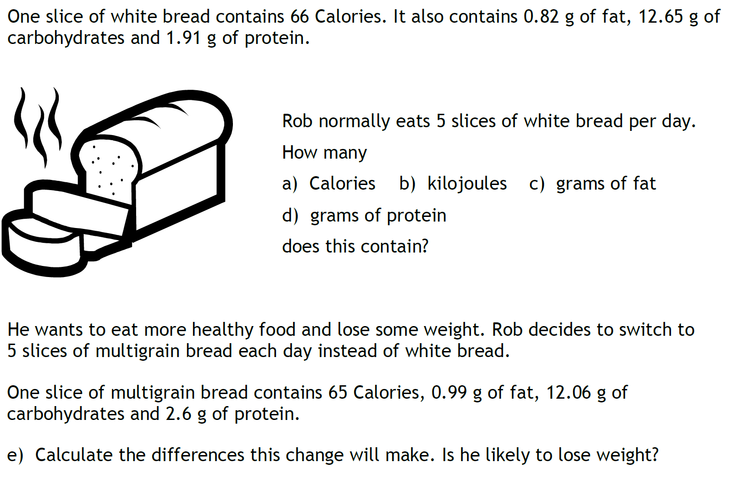
Task

Slide 12
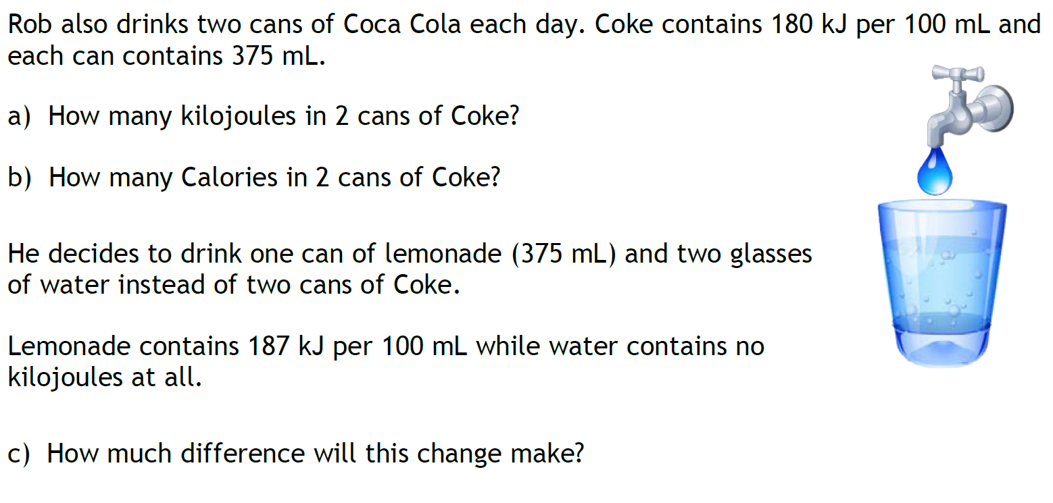
Task

